Slide 1
Effective Unsupervised Matching of Product Titles with k-Combinations and Permutations
Leonidas Akritidis, Panayiotis Bozanis
Department of Electrical and Computer Engineering
University of Thessaly, Greece

Slide 2
The problem (1)
We are given a set of F={f₁,f₂,…f_{N}} product feeds (usually in XML format).
Each feed f_{i} originates from an electronic store e_{i} and contains product records.
Each product record p may contain multiple fields (title, description, price, brand, category, etc).
A product cannot appear more than once in the same feed.
But it may appear in multiple feeds.

Slide 3
The problem (2)
A product may be described differently in these feeds (i.e. it appears under different titles).
E.g. “Apple iPhone 7” and “iPhone 7” are different titles which refer to the same product.
The problem: Match the product titles and identify if they describe the same product.
Useful for:
Price comparison applications & platforms.
Reviews merging & aggregation.
Users who desire to compare characteristics & prices.

Slide 4
Similarity/Distance Metrics
“Apple iPhone 7” and “iPhone 7” are different titles which refer to the same product.
Even though a whole word is missing from the second title (small similarity/distance).
“Apple iPhone 7” and “Apple iPhone 6” are titles which DO NOT refer to the same product.
Even though they only differ by a single character (higher similarity/distance).
Similarity/Distance metrics (cosine, Jaccard, edit distance, etc.) do not work well in this problem.

Slide 5
Supervised Clustering
For the same reason, the supervised machine learning clustering approaches (kNN, naïve Bayes, linear/logistic regression) also do not work well.
Smaller distances/higher probabilities should not necessarily be clustered to the same entity.
Higher distances/smaller probabilities should not necessarily be clustered in different entities.

Slide 6
State-of-the-art (1)
V. Gopalakrishnan, SP. Iyengar, A. Madaan, R. Rastogi, S. Sengamedu. Matching product titles using web-based enrichment. In Proceedings of the 21st ACM international conference on Information and knowledge management, pp. 605-614, 2012.
N. Londhe, V. Gopalakrishnan, A. Zhang, HQ Ngo, R. Srihari. Matching titles with cross title web-search enrichment and community detection. In Proceedings of the VLDB Endowment, pp. 1167-1178, 2014.

Slide 7
State-of-the-art (2)
These approaches are similar:
They enrich each product title by injecting several missing words.
They treat each word in the products’ titles differently, i.e. each word is assigned an importance score.
After these two preprocessing phases, they apply the cosine similarity measure (with an over simplistic blocking method).
They create clusters which consist of the same products.

Slide 8
State-of-the-art - Disadvantages
One query submitted to a SE per product:
this approach is infeasible for large-scale datasets.
In their experiments they use only 2 feeds.
Most platforms include thousands of electronic stores (i.e. product feeds).
They employ the cosine similarity metric.
which does not perform well in this problem.

Slide 9
Our approach is…
Standalone: It does not rely on external data sources (i.e. Web search engines, Web sites, ect).
Unsupervised: No requirement to manually train a classifier, or split the dataset in training and testing data subsets.
Efficient: Faster than the adversary approach; it makes use of in-memory data structures.
Flexible: It facilitates product classification into multiple clusters.

Slide 10
Overview (1)
Our proposed method operates in 2 phases:
Phase 1: construction of two primary data structures:
A lexicon which consists of all the k-combinations of the titles’ words, along with a frequency value and some statistics.
Each k-combination is a candidate product cluster.
A forward index: An array which stores for each product, a list of pointers to the respective title k-combinations (we use pointers to avoid saving the same data twice).

Slide 11
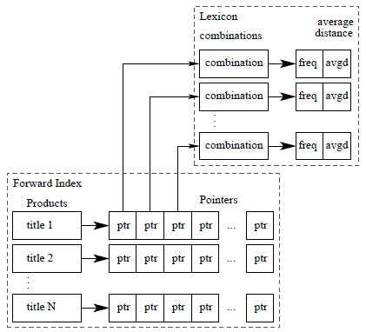
Overview (2)
Phase 2: We employ these two data structures to assign scores to each k-combination of each product.
The k-combinations are then sorted by decreasing score value and the highest scoring combination represents the cluster.

Slide 12
k-combinations
k-combinations are combinations of the words of the product title.
Length (number of words) = k.
Without repetition.
Without care for word ordering.
We compute the K-combinations of each product title,
Number of combinations for a title which consists of n words:

Slide 13
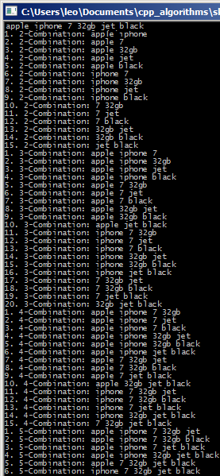
Phase 1 (1)

Slide 14
Data Structures - Lexicon
We employ a lexicon structure L to store the combinations. We also store two statistics:
A frequency value which represents the number of documents which contain this combination.
Frequent combinations are more likely to be declared cluster labels.
A distance value which stores the average distance of the combination from the beginning of the titles.
The most important terms in a product description appear early in the titles.

Slide 15
Data Structures – Forward Index
We also employ a forward index I which for each product p, stores a pointer to each combination.
We assign a score value to each combination in I.

Slide 16
Distance
Some frequent terms in the titles have no informational value (i.e. they do not describe the product, but they contain offers, specs, etc).
E.g. many products have in their titles the terms “EU”, “OEM”, “Retail”, etc.
Therefore, in some cases we get wrong cluster labels, e.g. “Apple iPhone EU”.
Similar problems can also be caused by other words: colors (black, white, red, etc), sizes (large, small, etc) and others.
Key observation: These terms usually appear late in the title (i.e. in high position).

Slide 17
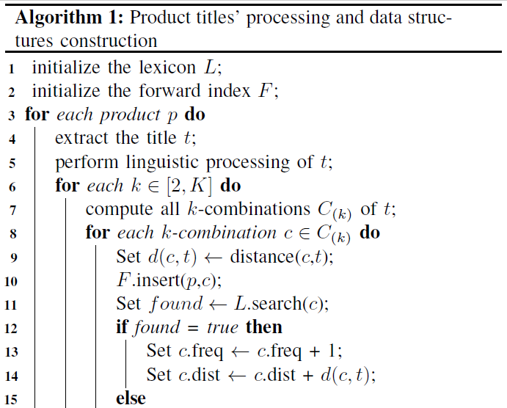
Phase 1 (2)

Slide 18
Permutations (3)
In case a combination is not found in the lexicon, we compute all its permutations.
We search for each permutation in the lexicon.
In case it is found, we increase the frequency of the corresponding combination and we stop searching.
In case it is not found, we do not insert it
We shall insert the corresponding combination instead, after all the permutations have been examined.

Slide 19
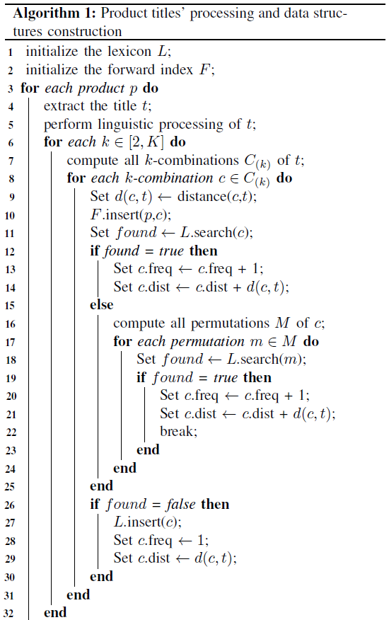
Phase 1 (3)

Slide 20
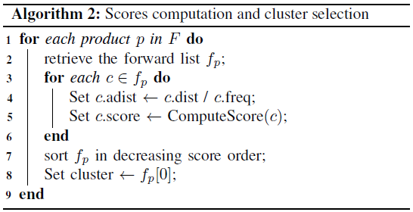
Phase 2
In phase 2 we compute the scores of each k-combination of each product.
To achieve this goal we use the forward index.
We sort the forward list in decreasing score order.
The first element of the sorted list is the cluster.

Slide 21
An indicative score function
Score function
where l(c) is the length of the combination/label, N(c) is the frequency, and d(c,t) is the average distance of the combination from the beginning of the string.

Slide 22
Results
We deployed a focused crawler on skroutz.gr and we collected 16208 products (mobile phones) classified in 922 clusters.
Vendors: 320
Average number of words in a title: 9
We consider the classification of skroutz.gr as the ground truth and we compare the effectiveness of our algorithm (UMaP) against this.

Slide 23
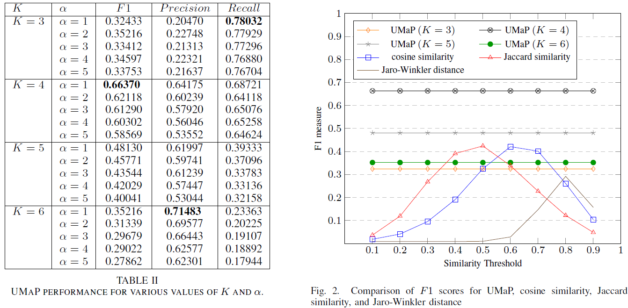
Effectiveness – F1 measure

Slide 24
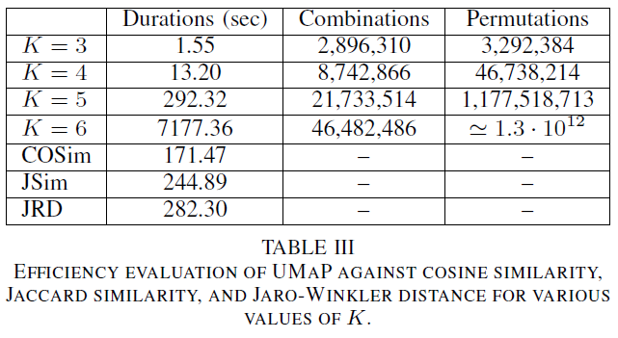
Efficiency

