Slide 1




blind man's shoe
Polatidis Christos
#Haptics #Embedded Systems
@ iee.ihu
iee2020262@iee.teithe.gr
12/2023

Slide 2
agenda
INTRODUCTION 3
TECHNOLOGIES USED 4
CONNECTIVITY 5
CODE ARDUINO C 6-8
CASE DESIGN 9-12
ASSEMBLY / TESTING 13-14
EVALUATION 15
SUMMARY 16
FUTURE IMPROVEMENTS 17

Slide 3
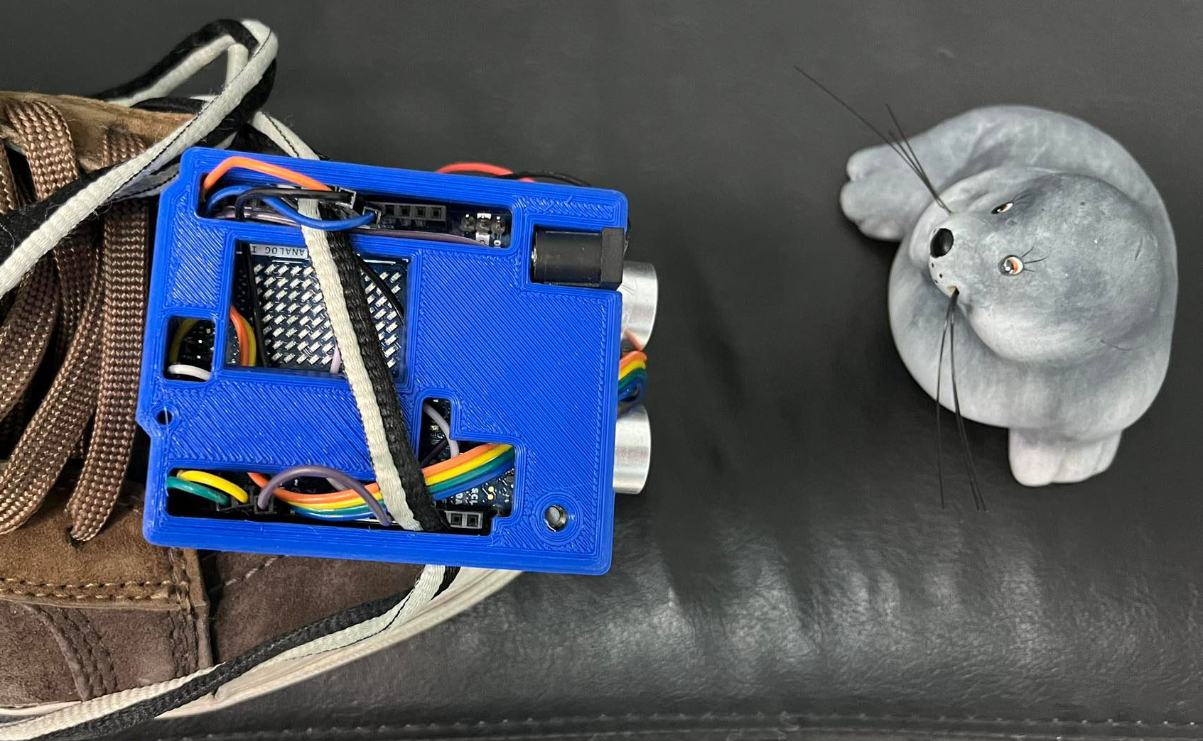
Introduction
A vibration obstacle avoidance device for people with vision problems.
Use case
A visually impaired person adapts the device on his shoe. The device senses the obstacles in front of him and alerts him by vibration. Depending on the distance of the obstacle, the device sends out a different vibration pulse so that the end user can distinguish between them.

Slide 4
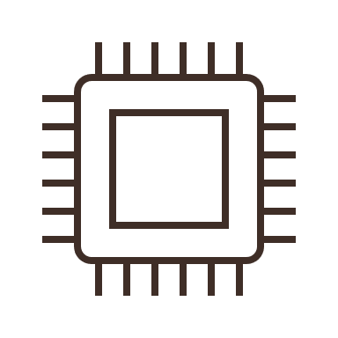

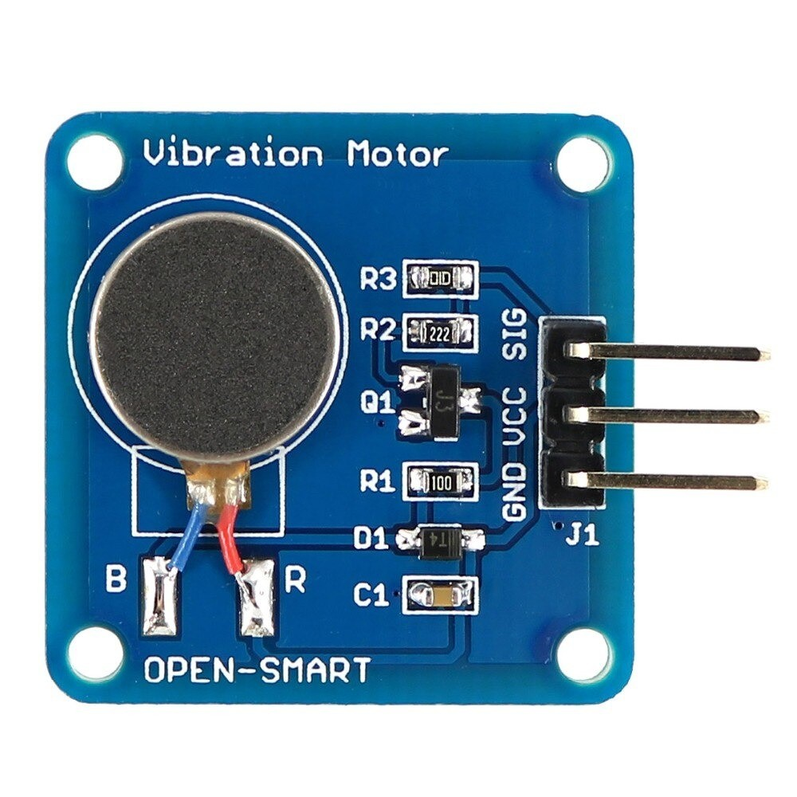
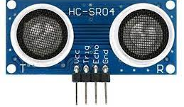
Technologies used
Hardware
Arduino
Arduino uno r4 WiFi
Supersonic sensor
Vibration Motor Module
9V battery

Slide 5
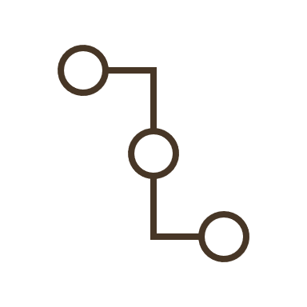
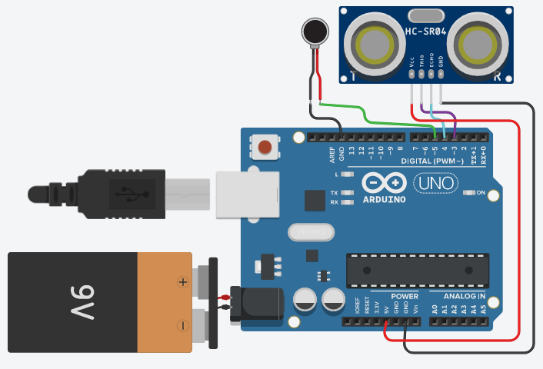
Connectivity

Slide 6
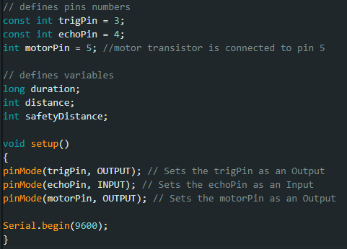
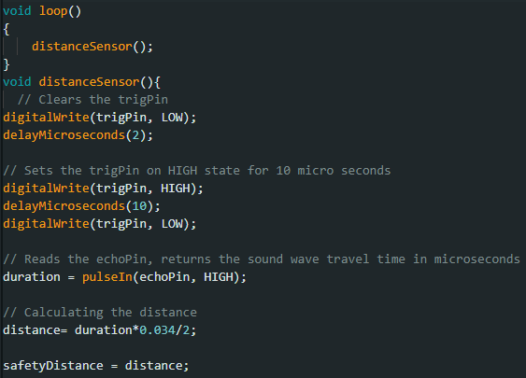
Code 1/2
distanceSensor function 1/2
Define pins

Slide 7
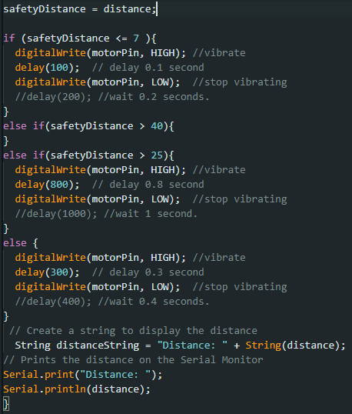
Code 2/2
distanceSensor function 2/2
4 situations / 3 controls
<=7
>25
>40
High
Mid
Low
No
Vibration

Slide 8
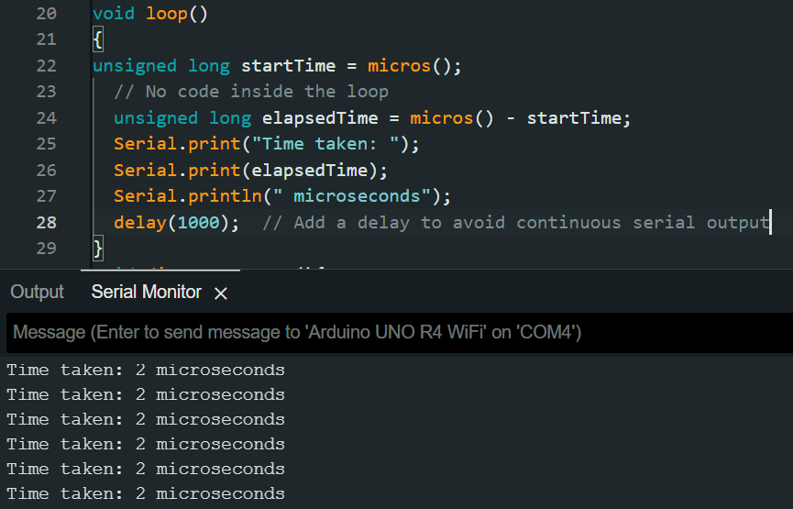
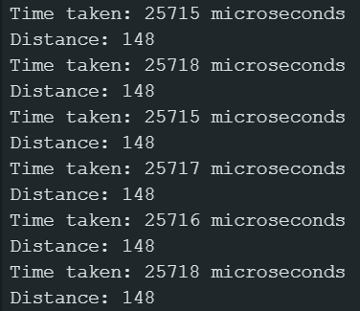
Experiment code
The default operating frequency for Arduino UNO r4 is 16 MHz
Experimentally, by this code, the measured time between each loop in Arduino r4 is 2 microseconds
The measured time with the shoe's operation inside the loop is about 25,71 milliseconds
[1]
Empty loop
shoe's operation loop

Slide 9
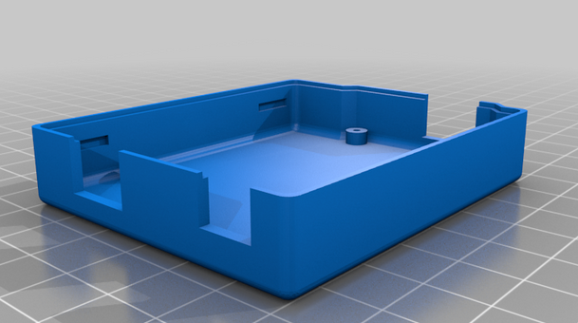
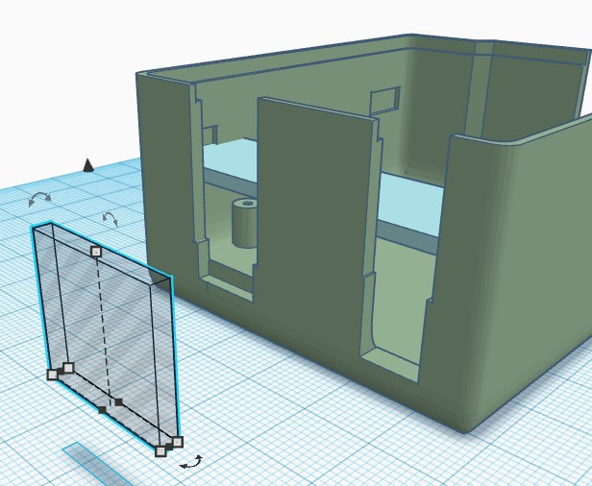
Case Design 1/4
Arduino uno r4 WiFi case
Tinkercad Design
[3]
[2]

Slide 10
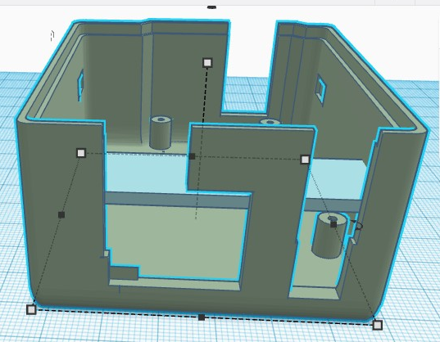
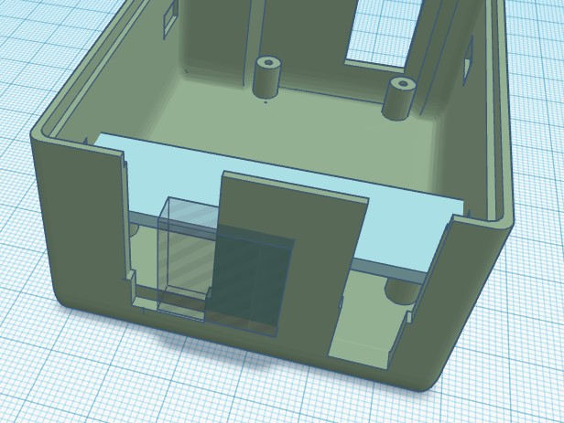
Case Design 2/4

Slide 11
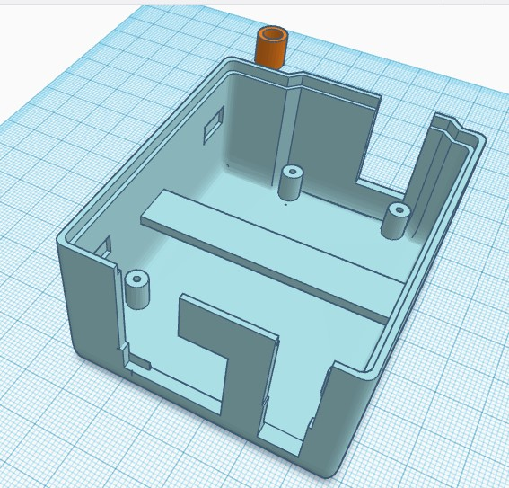
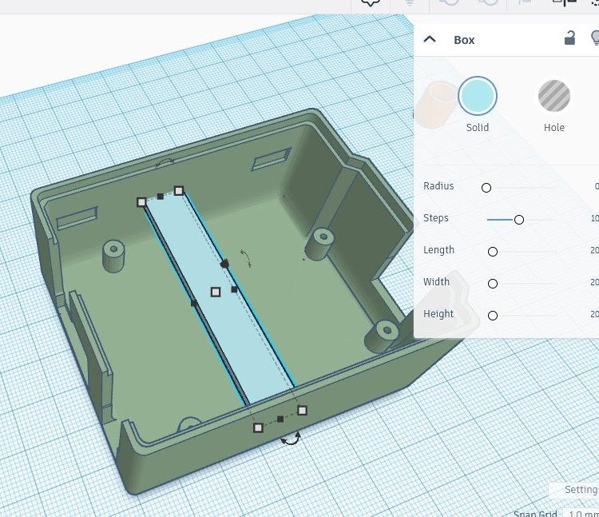
Case Design 3/4

Slide 12
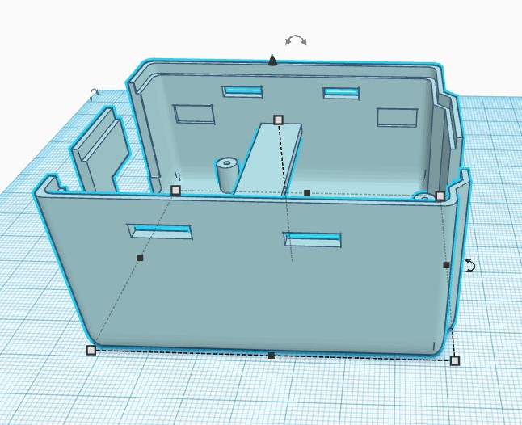
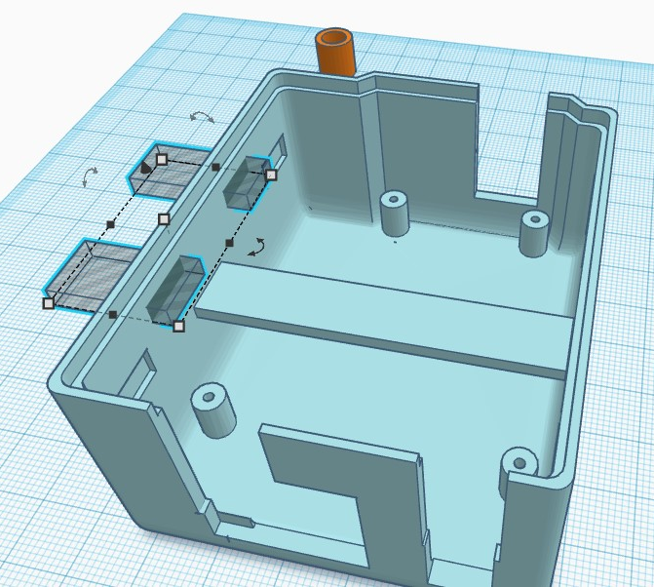
Case Design 4/4

Slide 13
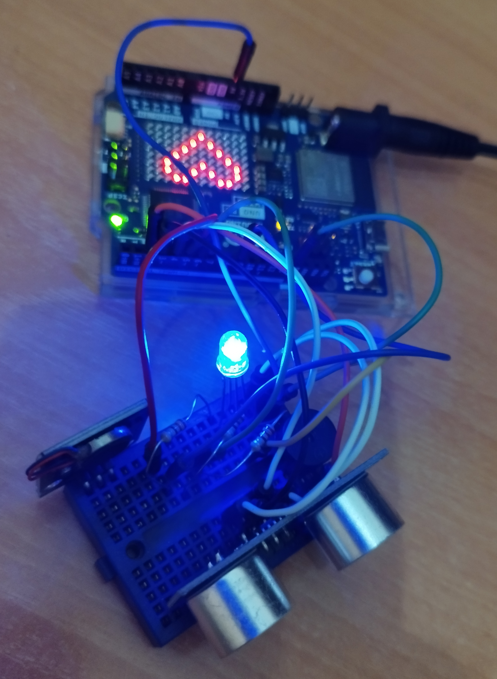
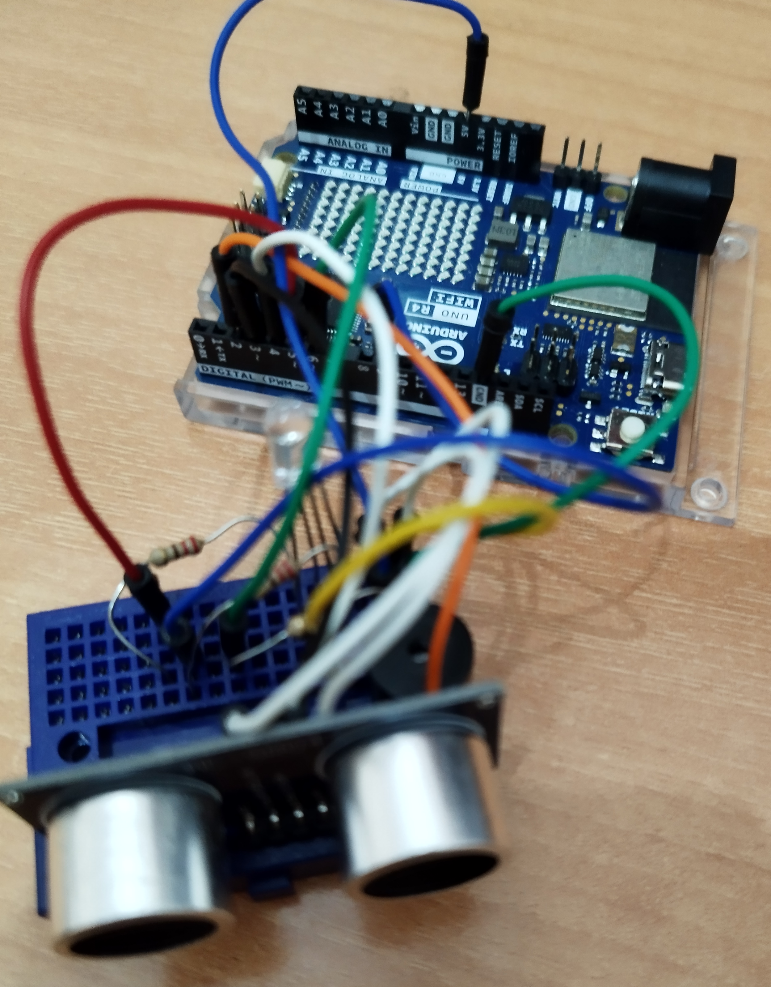
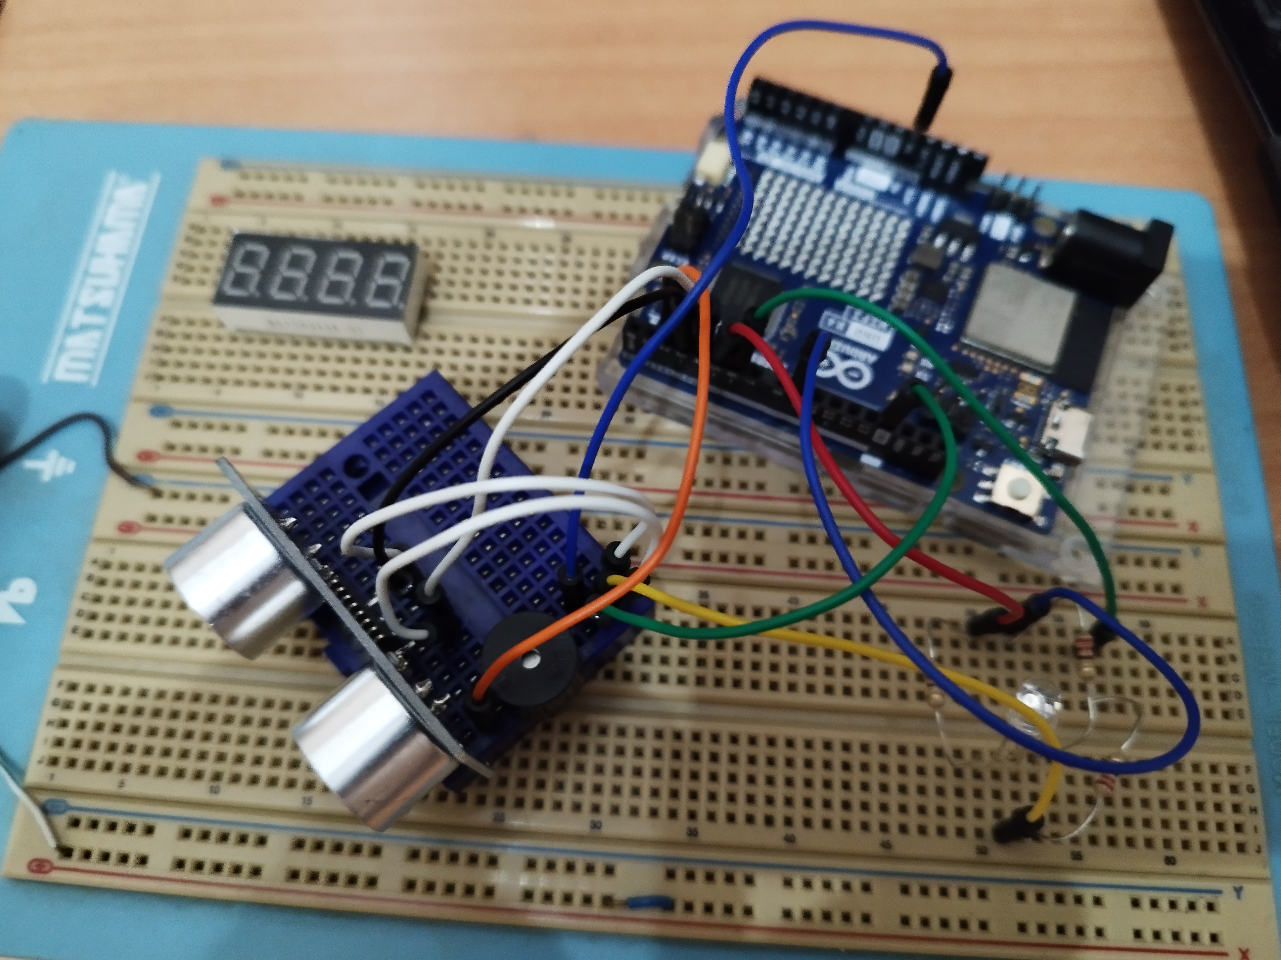
Assembly

Slide 14
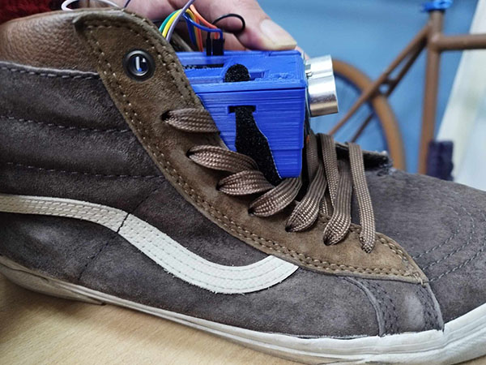
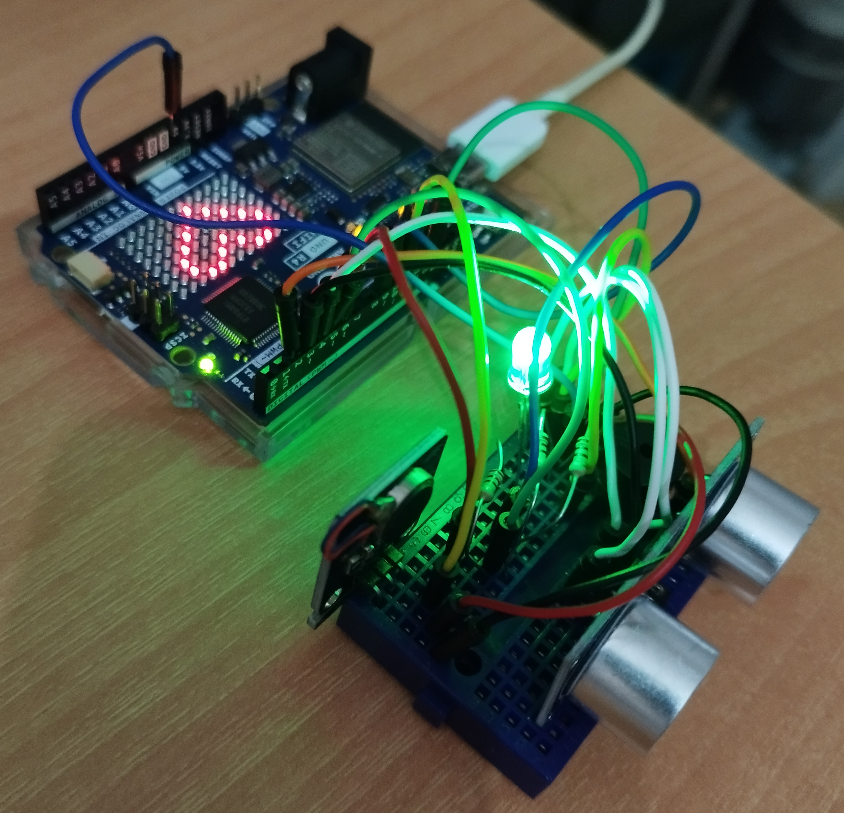
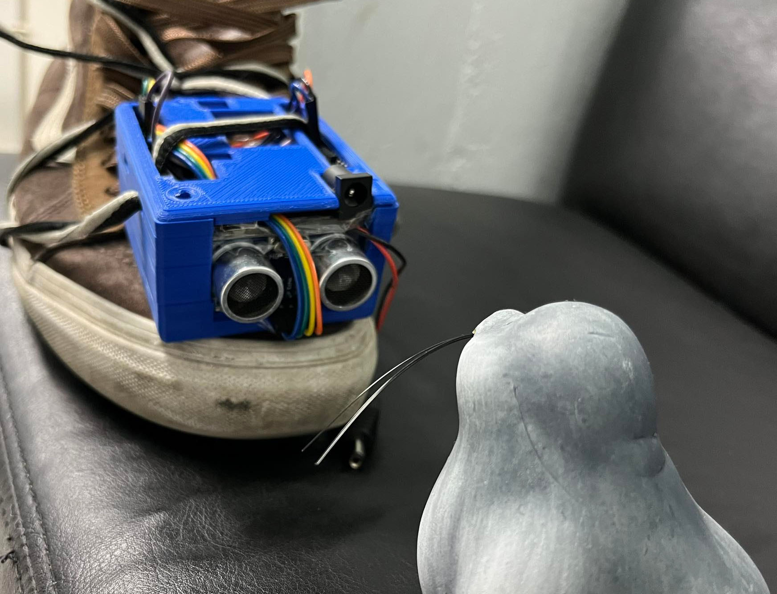
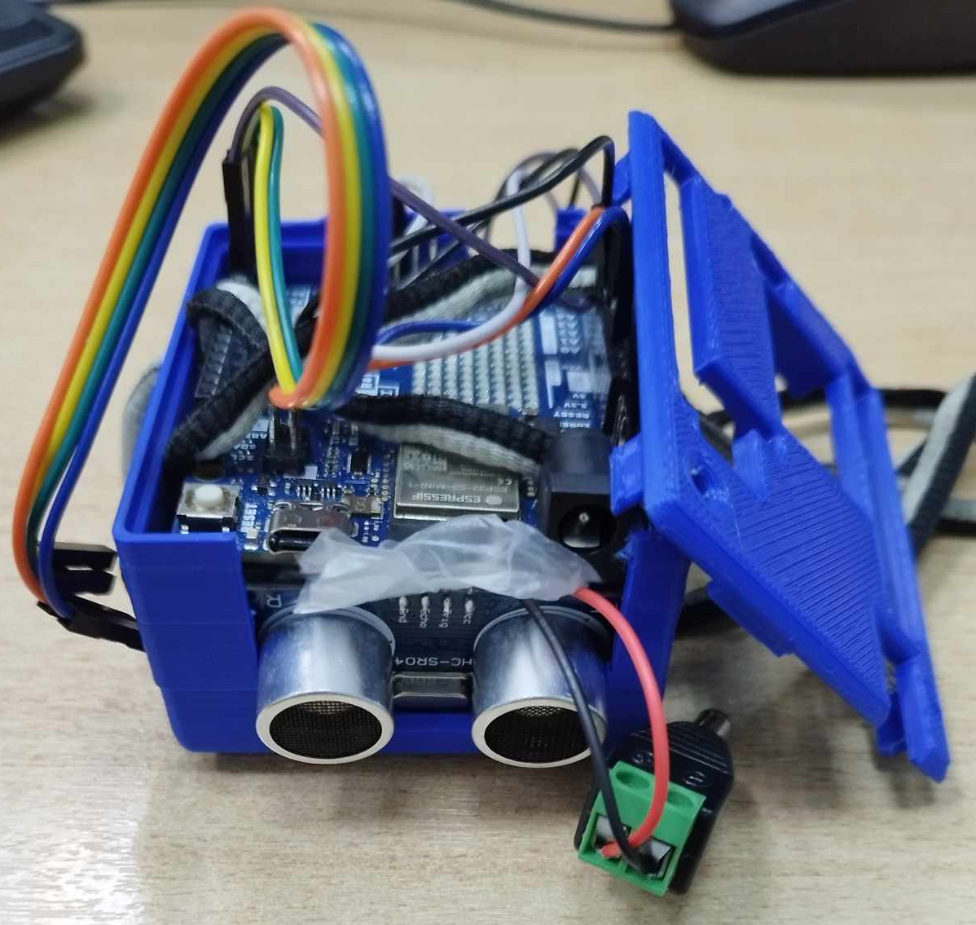
Testing

Slide 15
Evaluation
25 people (Ages 18-45)
USE questionnaire
(22 questions)
Usefulness 82%
Ease of use 79%
Ease of learning 92%
Satisfaction 80%

Slide 16
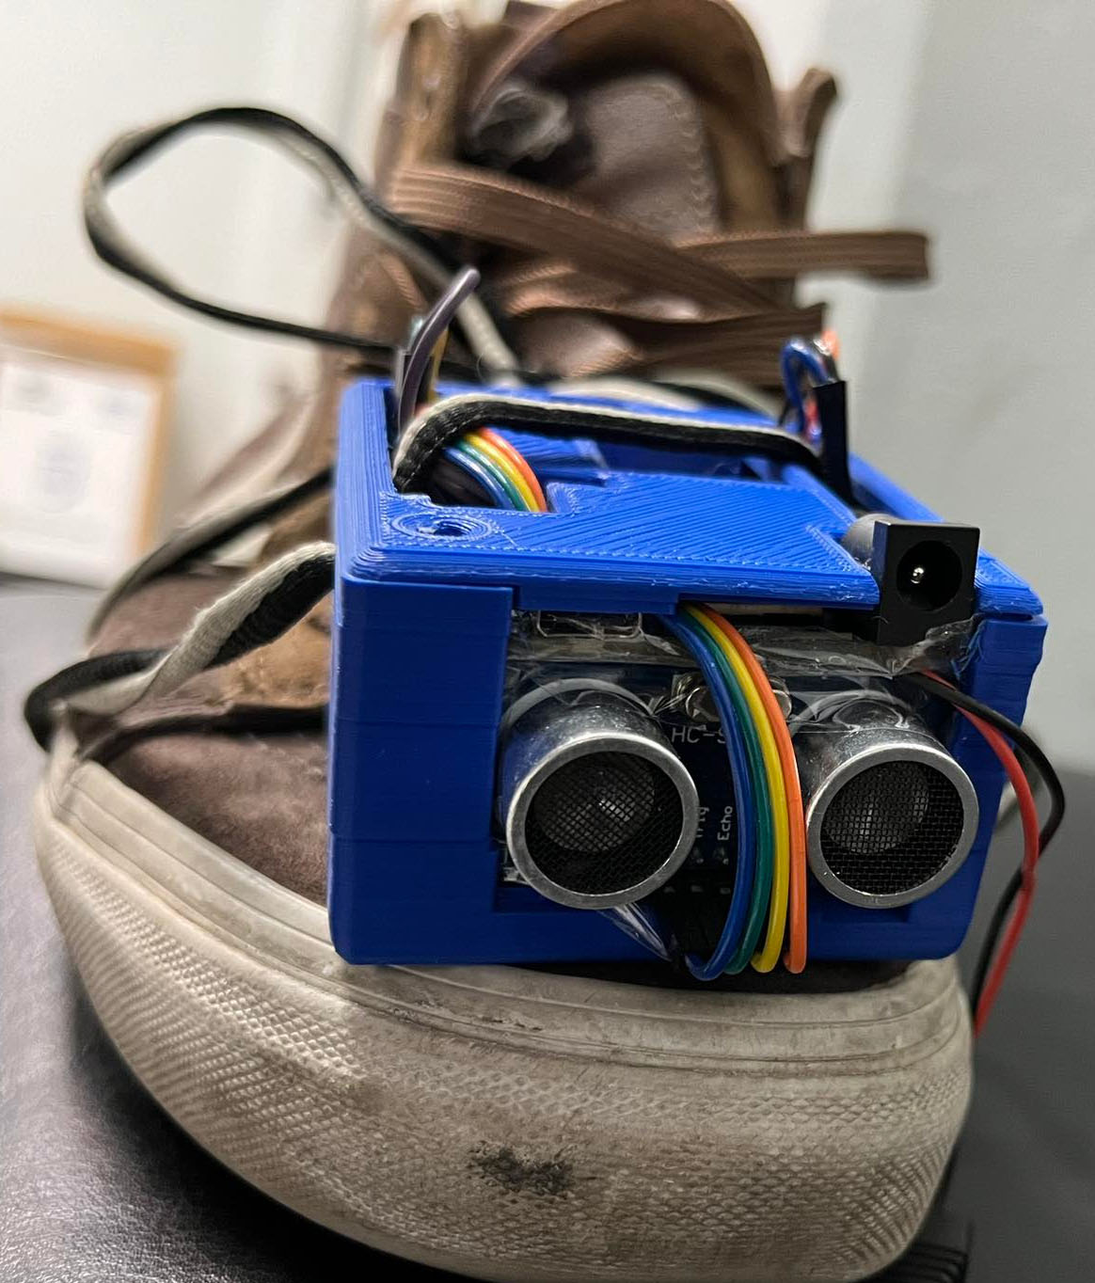
Summary
Modern technologies offers easy implementation of innovative systems.
We need to choose technologies that fit our energy and size requirements.
Testing of use cases independently before mounting.
We need to calculate enough time for testing as the final product is improved to a great percentage through this process.
Digital printing gives us the ability to create our own case using an existing template.
Evaluation is important to improve our prototype.

Slide 17
Future improvements
Using a smaller microcontroller
Design a curve case that fits to the shoe
The case should allow the vibrator to be near the foot using a hole
Creating a rechargeable function
Design an on/off button in the case
Use additional sensors covering all directions
Using gyroscope for better obstacle avoid

Slide 18



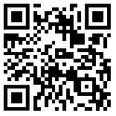
thank you
Questions ?
https://github.com/iratus7/Shoe-For-Blind

